Slide 1


Optimizing RAG Architectures for
Low-Latency, Cost-Constrained
Micro-SaaS Platforms in Tourism
A proposed methodology for decoupling applications from continuous LLM processing using a Semantic Caching Layer.
U. Dinul Kithsara De silva
Registration No: MS25905922
MSc in Information Technology – Enterprise Applications Development (IT6010)
Supervisor: Dr. Dinuka Wijendra
Sri Lanka Institute of Information Technology (SLIIT)
Notes:
simply this research proposes a methodology to decouple applications from continuous, expensive LLM processing by introducing a highly specialized, geo-partitioned Semantic Caching Layer. Let's begin by looking at the core problem this research solves.

Slide 2

Research Problem
Unsustainable Operational Costs
Traditional RAG pipelines rely on continuous, expensive cloud-based LLM inference, making them
financially unviable for bootstrapped Micro-SaaS startups.
Unacceptable Latency Bottlenecks
Routing every repetitive query to the LLM creates redundant compute cycles, resulting in poor user.
response times (3–5 seconds).
Localized Knowledge Deficits
Standard baseline LLMs lack native understanding of hyper-local Sri Lankan colloquialisms
(eg, tuk-tuk , kottu kade ), leading to translation breakdowns for foreign tourists.
Geographic Hallucinations & Cache Collisions
Standard caching mechanisms fail to distinguish between structurally similar but geographically
distinct intents (eg, swapping "Colombo" for "Kandy"), actively misrouting tourists.
Notes:
This research addresses four critical failures when applying standard AI to local tourism. First, relying entirely on cloud LLMs creates unsustainable operational costs for bootstrapped Micro-SaaS startups. Second, processing every query through an LLM causes unacceptable 3-to-5-second latency bottlenecks, ruining the user experience. Third, baseline models suffer from localized knowledge deficits—they completely fail to understand Sri Lankan terms like 'kottu kade' or 'tuk-tuk,' breaking down communication for foreign tourists. Finally, standard semantic caches cause dangerous geographic hallucinations, often misrouting tourists by confusing identical queries meant for different cities, like swapping 'Colombo' for 'Kandy.' Our architecture solves these exact gaps.

Slide 3
The Solution
Semantic Caching Engine
Implements a Redis vector cache to intercept and resolve repetitive user intents instantly, reducing latency to < 200ms and eliminating API
token costs.
Dual-Dataset Knowledge Pipeline
Integrates a hyper-local Sri Lankan tourism glossary alongside standard itinerary reviews, creating a mathematical 2-way translation bridge.
for cultural colloquialisms.
Defensive Hallucination Guards
Deploys Geographic Pre-Filtering (@district ) Traps to mathematically isolate regions and completely eliminate proper-
noun cache collisions.
Cloud-Independent Micro-SaaS Deployment
Orchestrates a lightweight, Dockerized local environment utilizing a quantized Llama-3 model (Ollama) to ensure data privacy and extreme
cost-efficiency on budget hardware.
Notes:
To overcome these challenges, our solution introduces four key architectural pillars. First, a Semantic Caching Engine built on Redis that resolves repetitive queries, reducing the latency to under 200 milliseconds and completely eliminating API token costs. Second, a Dual-Dataset Knowledge Pipeline that mathematically bridges standard English reviews with hyper-local Sri Lankan terminology using a dedicated glossary vector space. Third, we implemented Defensive Hallucination Guards—using geographic @district pre-filtering to mathematically isolate regions and eliminate cross-city cache collisions. Finally, the entire system is wrapped in a Cloud-Independent Deployment, utilizing a quantized LLaMA-3 model in Docker to guarantee data privacy and cost-efficiency on budget hardware.

Slide 4
Novelty & Domain Contribution
The 2-Way Cultural Translation Bridge (Context Specificity)
Mathematically encodes hyper-local Sri Lankan colloquialisms (eg, tuk-tuk , kade ) into a localized vector glossary, pioneering a domain-
specific adaptation that natively bridges the linguistic gap for foreign tourists.
Hybrid Defenses Against Cache Collisions
Introduces two custom algorithmic guards—Geographic Pre-Filtering ( @district) and the Lexical Jaccard Penalty Trap—mathematically
eliminating the risk of tourists receiving misrouted, hallucinated regional itineraries.
Programmatic Cost-Benefit Validation
Moves beyond theoretical cost savings by introducing a live benchmarking script that quantitatively proves absolute zero-cost API overhead.
And sub-200ms latency during semantic cache interception.
Cloud-Independent Generative Architecture
Demonstrates that highly secure, context-aware Generative AI can be orchestrated entirely on resource-constrained, localized microservices
without relying on expensive enterprise cloud hyperscalers.
Notes:
The true novelty of this research lies in four major domain contributions. First, we pioneer a 2-Way Cultural Translation Bridge, embedding a dedicated vector glossary that natively translates hyper-local Sri Lankan terms for foreign tourists. Second, we introduce Hybrid Defenses against Cache Collisions. By combining geographic pre-filtering with algorithmic intent traps, we mathematically eliminate the risk of misrouting tourists to the wrong region. Third, we provide Programmatic Validation, empirically proving zero-cost API overhead and sub-200 millisecond latencies. Finally, we demonstrate a Cloud-Independent Architecture—proving that secure, context-aware Generative AI can be run entirely on localized, budget-friendly microservices without relying on expensive cloud hyperscalers.

Slide 5
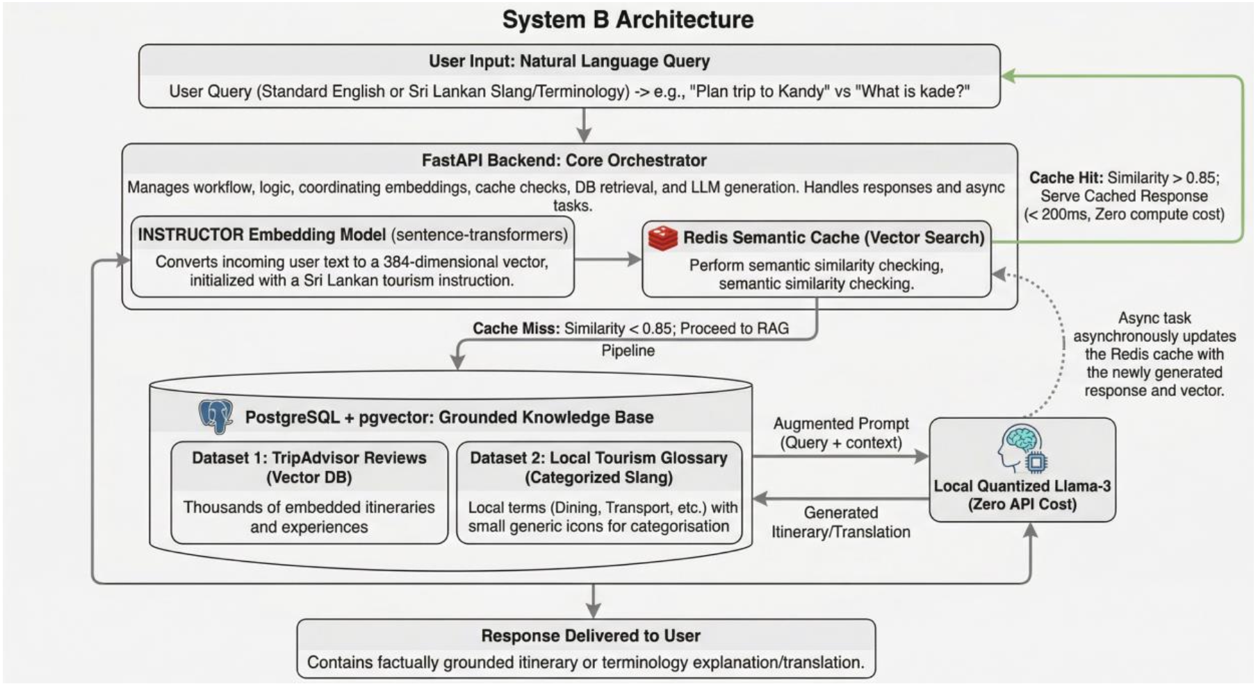
System Architecture

Slide 6
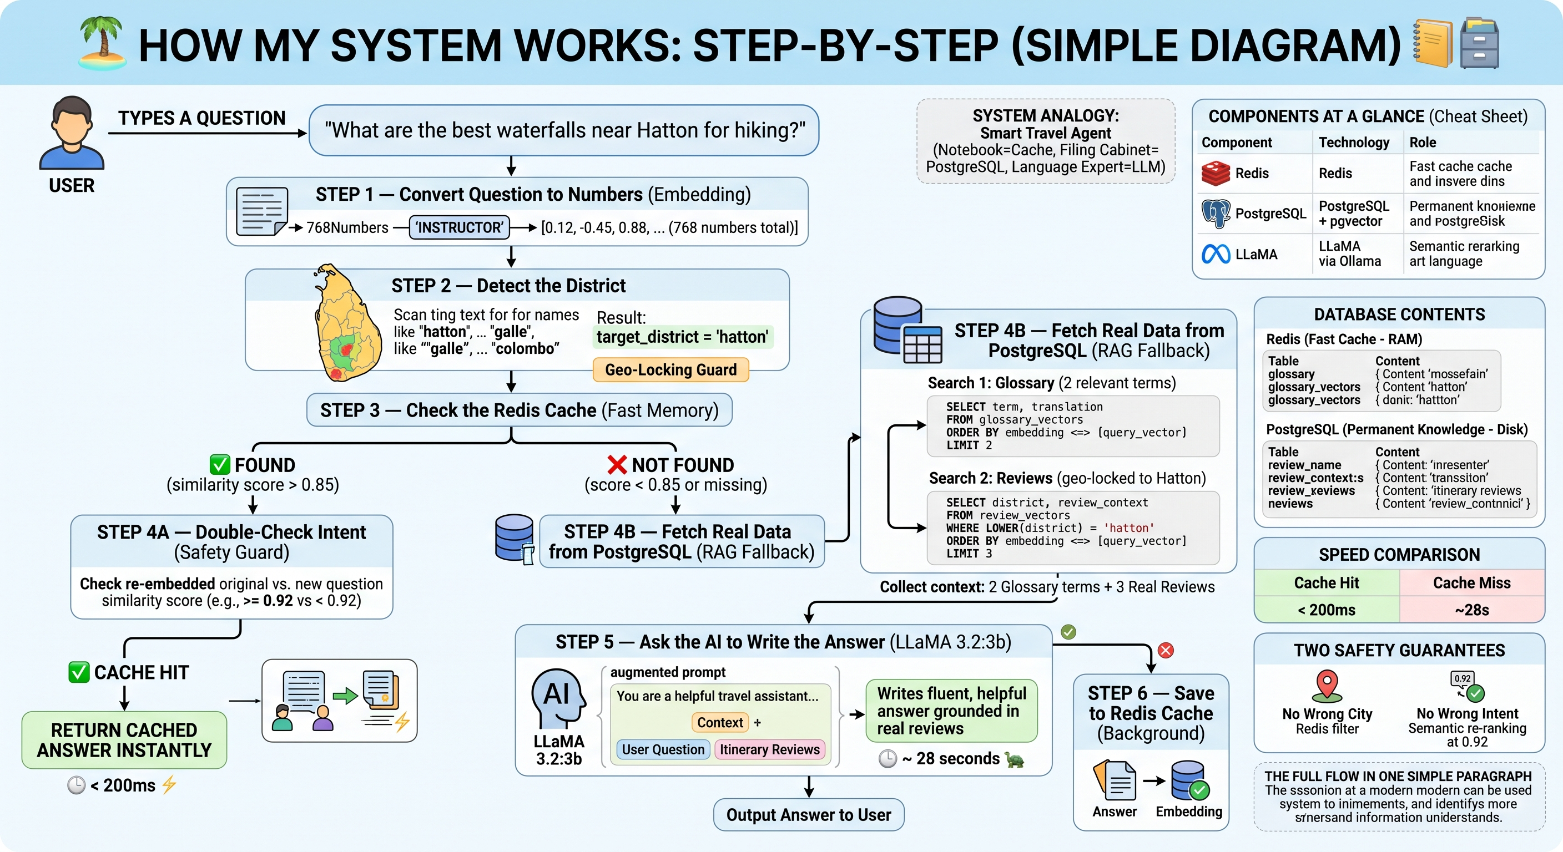
How the system works

Slide 7
Methodology & System Implementation
Containerized Microservice Orchestration
Deployed a lightweight, localized Docker environment integrating FastAPI (routing), Redis Stack (caching), PostgreSQL + pgvector(database)
and a 4-bit quantized Llama-3 via Ollama (inference).
Dual-Dataset Vectorization
Processed standard itinerary reviews and the custom Sri Lankan tourism glossary into 768-dimensional mathematical coordinates using the
deep-learninginstructor-base embedding model.
Dual-Path Routing & Defense Logic
Engineered the backend logic funnel to seamlessly route queries to either the Fast Path (Semantic Cache) or the Slow Path (RAG Fallback),
fortified by Geographic and Lexical Cache Guards.
Programmatic Load-Testing & Validation
Developed custom Python benchmarking scripts to simulate high-volume, real-world API traffic, quantitatively calculating latency reductions
and exact API token cost savings.
Notes:
For implementation, we followed four key methodological steps. First, we deployed a fully Containerized Microservice Architecture using Docker, integrating FastAPI, Redis Stack, PostgreSQL with pgvector, and a 4-bit quantized LLaMA-3 model through Ollama — all running entirely offline. Second, we performed Dual-Dataset Vectorization, converting 13,668 tourist reviews and our custom Sri Lankan glossary into 768-dimensional vectors using the INSTRUCTOR embedding model. Third, we engineered a Dual-Path Routing and Defense Logic — intelligently directing each query to either the Fast Cache Path or the Slow RAG Fallback, protected by geographic and semantic intent guards. Finally, we validated everything using custom Python load-testing scripts, programmatically measuring latency reductions and confirming zero API token overhead.

Slide 8
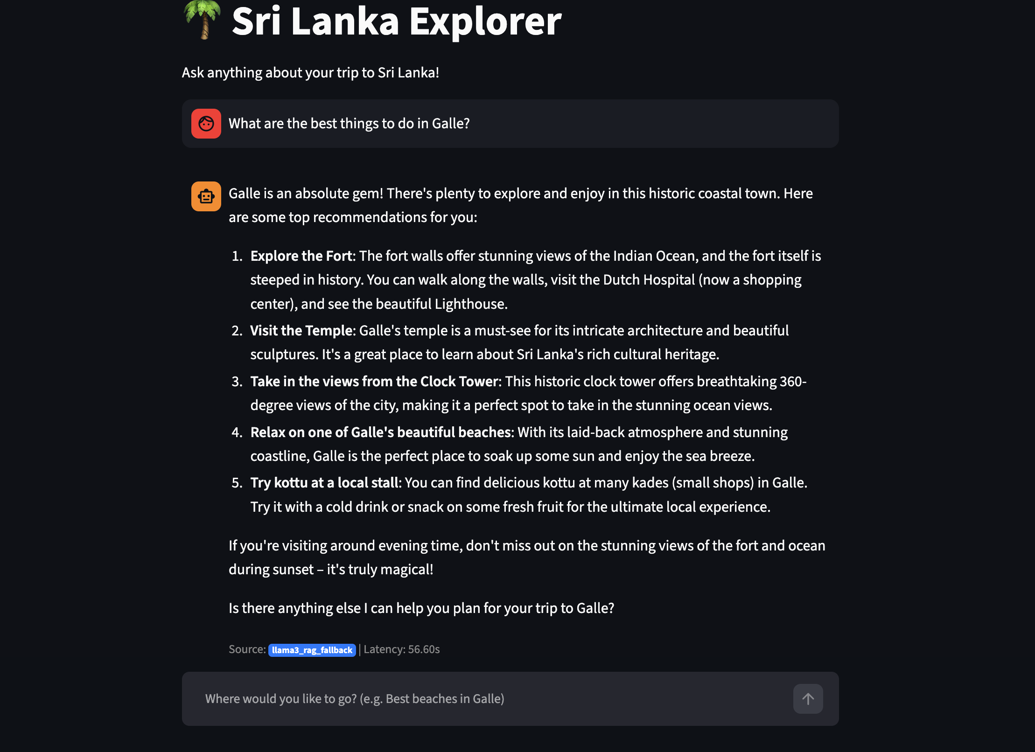
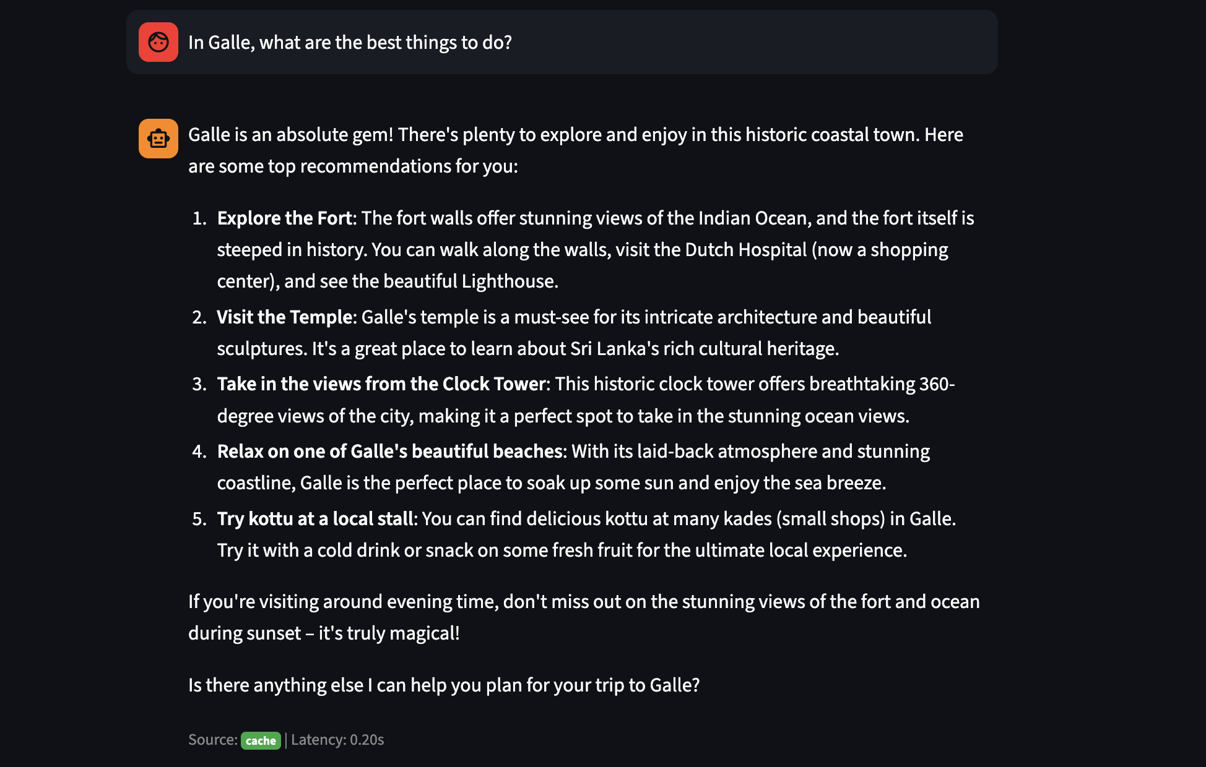
Results & Demonstration

Slide 9
Questions?
Thank you for your time and consideration.

Slide 10





Image Sources
https://img.freepik.com/premium-photo/abstract-digital-network-with-glowing-nodes-lines-representing-technology-connectivity_36682-100337.jpg
Source: www.freepik.com
https://static.vecteezy.com/system/resources/previews/060/597/882/non_2x/futuristic-node-concept-with-glowing-blue-energy-sphere-abstract-neural-connections-and-vibrant-electric-light-trails-on-a-purple-gradient-background-with-ui-elements-vector.jpg
Source: www.vecteezy.com
https://png.pngtree.com/thumb_back/fw800/background/20260110/pngtree-modern-dark-themed-data-analytics-dashboard-with-vibrant-accents-image_21052087.webp
Source: pngtree.com
https://png.pngtree.com/png-clipart/20250118/original/pngtree-futuristic-server-rack-with-blue-led-lights-on-a-dark-background-png-image_20228001.png
Source: pngtree.com
https://png.pngtree.com/thumb_back/fw800/background/20251210/pngtree-artificial-intelligence-network-a-glowing-microchip-with-ai-powered-neurons-image_20793795.webp
Source: pngtree.com

